Slide 1
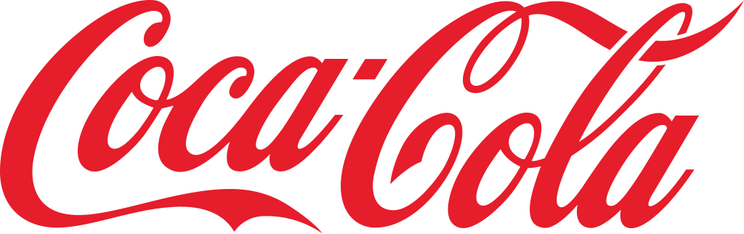
Retailer Sales Analysis
Created by: Harsh Naidu

Slide 2
Dataset Overview
Focus: Beverage sales and operating margins for Coca-Cola products.
Time Period: January to Dec 2021
Key Metrics:
Price per Unit
Units Sold
Total Sales
Operating Profit & Margin
Purpose: Analyze beverage performance, profitability, and margin trends across brands and periods.

Slide 3
Tools Used:
Microsoft Excel (Pivot Table)

Slide 4
Steps for Analysis
Imported a single clean dataset; no data modeling required.
Verified data consistency and used existing fields for analysis.
Created KPIs for Total Sales, Units Sold, Operating Profit & Margin.
Built visuals:
Line chart – Sales by Month
Map – Sales by State
Bar chart – Units Sold by Brand
Pie chart – Profit by Retailer
Added slicers for easy filtering by Retailer, Region, and Brand.
Derived key insights on top-performing brands, regions, and retailers.

Slide 5
Findings

Slide 6

The company achieved total sales of $86.8 million with 171 million units sold, generating an operating profit of $31.7 million and a strong profit margin of 36.3%.

Slide 7
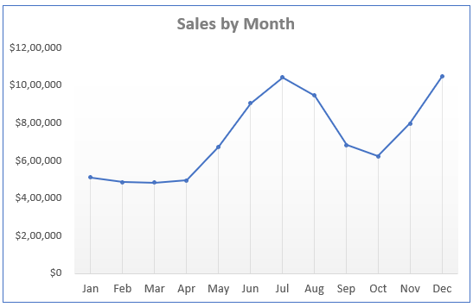
Which months recorded the highest and lowest beverage sales in 2021?
Sales peaked in July and December, while the lowest sales occurred around March–April.

Slide 8
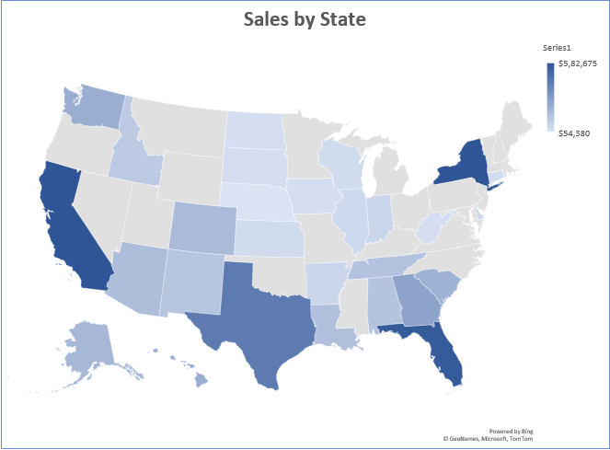
Which states recorded the highest beverage sales across the U.S.?
Texas, California, Florida, and New York achieved the highest sales, indicating strong regional performance in these states.

Slide 9
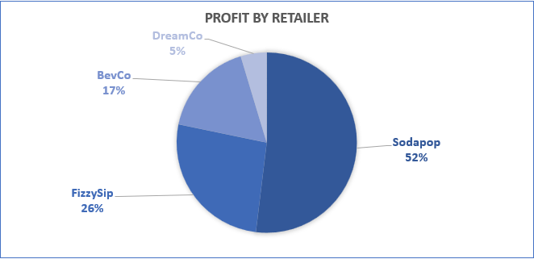
Which retailer contributed the most to total operating profit?
Sodapop dominated with 52% of total profit, followed by FizzySip at 26%, showing Sodapop’s major impact on profitability.

Slide 10
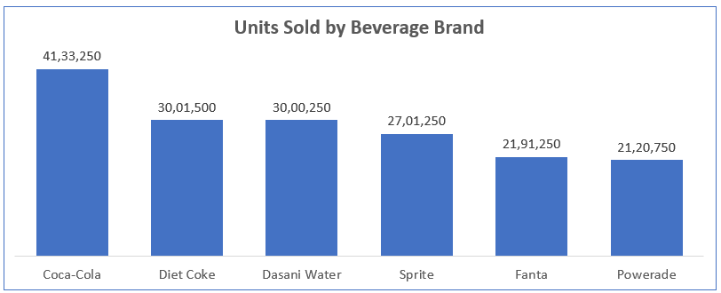
Which beverage brand achieved the highest sales volume?
Coca-Cola led with over 4.1 million units sold, outperforming other brands like Diet Coke and Dasani Water.

Slide 11
Recommendations:
Boost marketing in top states – Texas, California, New York.
Analyze low-sales regions for improvement opportunities.
Strengthen partnership with Sodapop; uplift other retailers.
Promote Coca-Cola and Diet Coke through targeted campaigns.
Launch seasonal offers in June–July and December.
Improve sales of Fanta and Powerade with new product strategies.

Slide 12
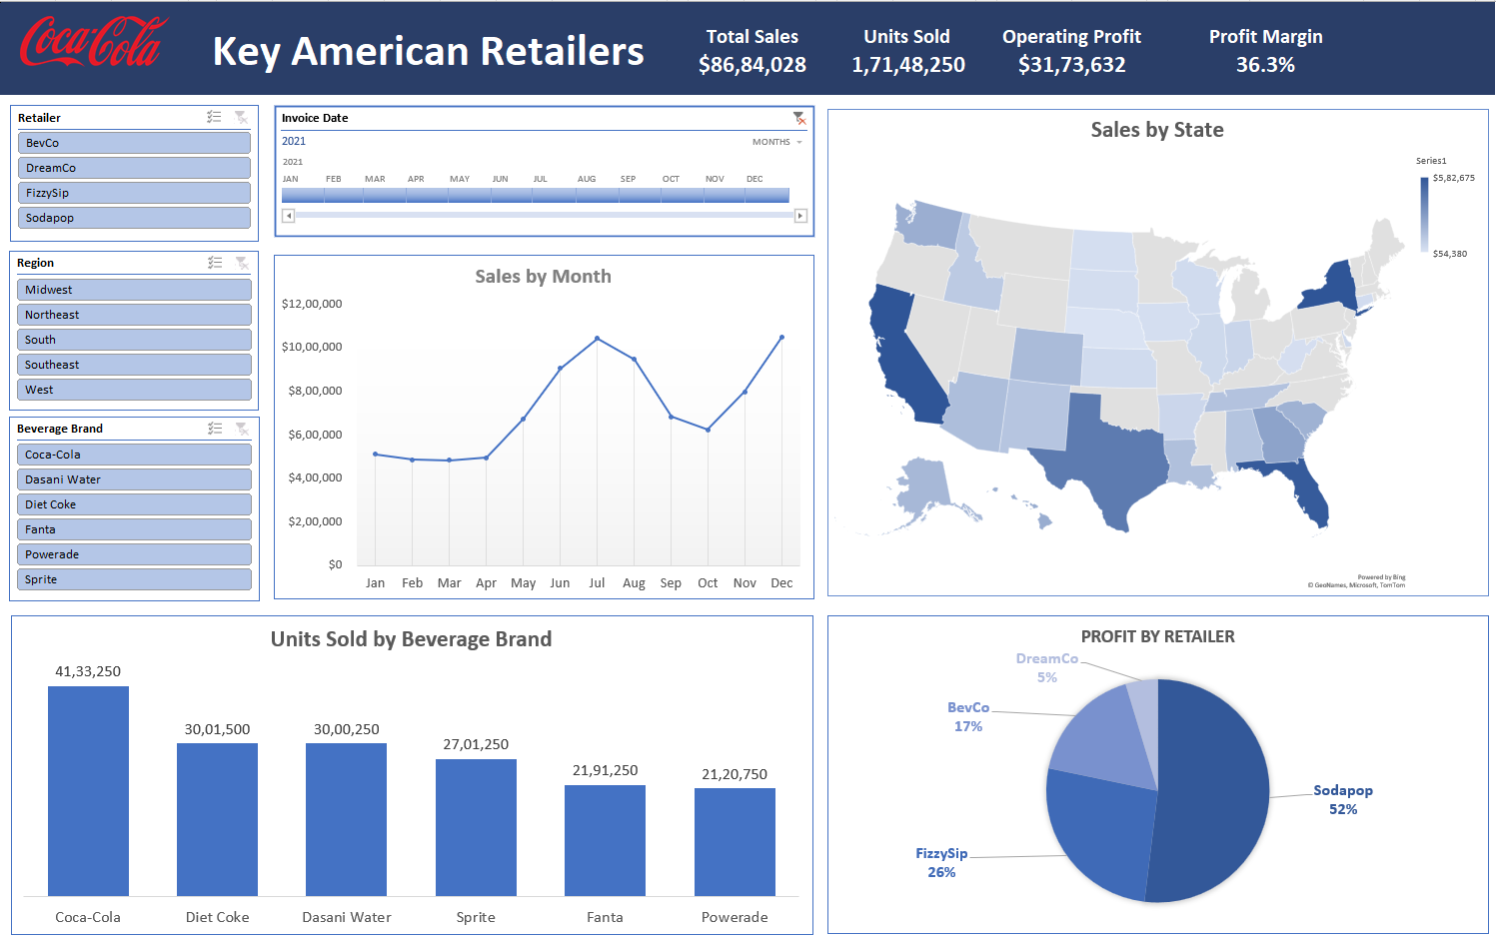

Slide 13
Thank You

